Slide 1
Addition of Groundwater Targets to Freshwater SBTs v2
Technical Background

Slide 2
Objective
Update v1.1 methodology to consider protection of groundwater
v1.1 defined the amount of water use a company can have in a basin while being protective of environmental flow requirements
v2 will define the amount of water use a company can have in a basin while being protective of environmental flow requirements and groundwater levels

Slide 3
Overview of Changes to v1.1 Steps
Calculate baseline water use
Select model
Assess required percent reduction in water use
Set targets
Notes:
The focus of this slide deck is to describe changes between v1.1 and v2.

Slide 4
Overview of Changes to v1.1 Steps
Calculate baseline water use
Disaggregate baseline to distinguish whether water supply comes from surface water and/or groundwater
Underlying theory is that protection of groundwater levels must be achieved via reduction in groundwater use
Select model
Assess required percent reduction in water use
Set targets

Slide 5
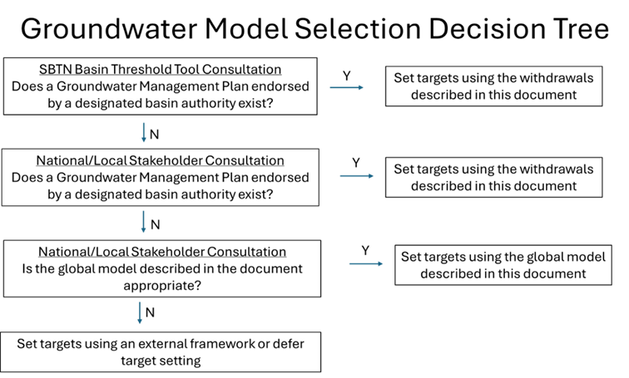
Overview of Changes to v1.1 Steps
Calculate baseline water use
Select model
If a groundwater management plan exists, use it as the basis for setting targets
If no management plan exists, use global model (if appropriate)
Assess required percent reduction in water use
Set targets
Notes:
Simpler approach than used for protection of stream flows because we are not requiring companies to see out and apply local models developed outside of an authorized management plan.

Slide 6
Overview of Changes to v1.1 Steps
Calculate baseline water use
Select model
Assess required percent reduction in water use
Define environmental threshold
Maintain stable aquifer levels into the future
Maintain aquifer levels within the root zone for groundwater-dependent ecosystems
Process global model results
Set targets

Slide 7
Overview of Changes to v1.1 Steps
Calculate baseline water use
Select model
Assess required percent reduction in water use
Define environmental threshold
Maintain stable aquifer levels into the future
Maintain aquifer levels within the root zone for groundwater dependent ecosystems
Process global model results
Set targets

Slide 8
Steps to Processing Global Model
Run global groundwater model (presumably GSGM) for a range of global pumping reduction scenarios (e.g., 0%, 10%, …, 90%, 100%)
Model outputs aquifer elevation over time at hi-resolution grid
Assess percent reduction in pumping necessary to achieve stable aquifer levels per grid cell
Consider groundwater dependent ecosystems, as appropriate
Spatially average reduction percentages across Pfafstetter Level 5 basins

Slide 9
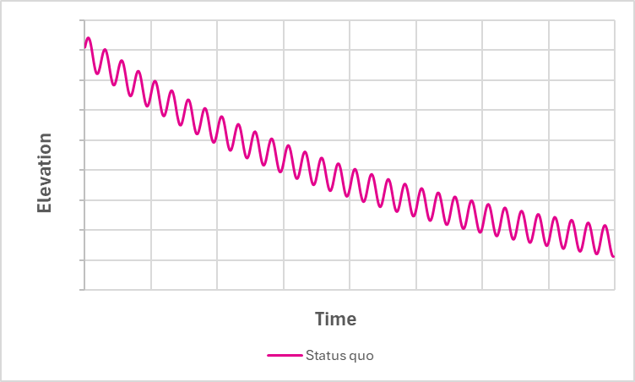
Hypothetical Model Result for Status Quo (0% Reduction) Monotonically Decreasing Aquifer Level
Status quo is unacceptable because groundwater levels continue to drop into the future

Slide 10
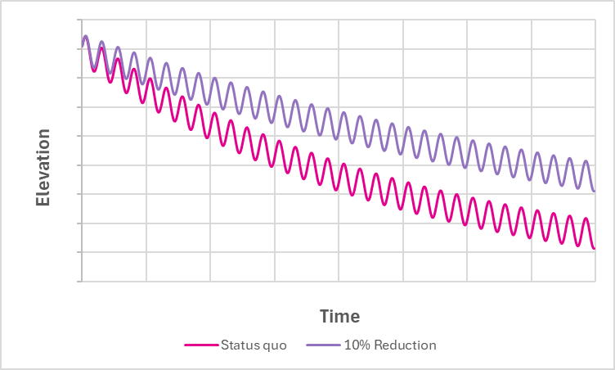
Hypothetical Model Result for 10% Reduction in Pumping Monotonically Decreasing Aquifer Level
10% reduction in pumping is also unacceptable because groundwater levels continue to drop into the future, albeit at a slower rate of decline

Slide 11
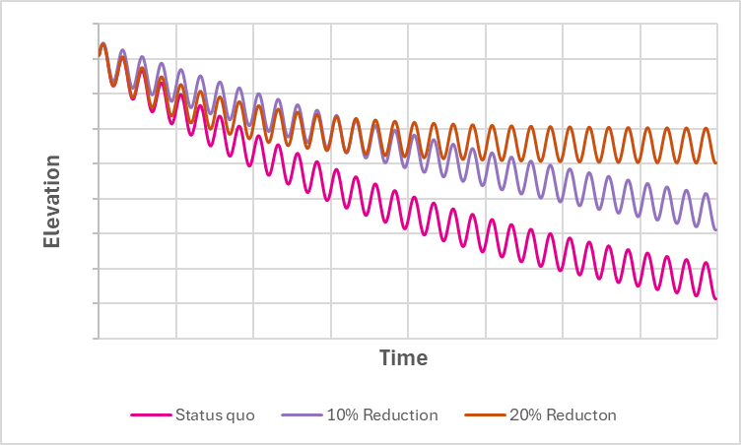
Hypothetical Model Result for 20% Reduction in Pumping Dynamically Stable Aquifer Level
20% reduction in pumping is acceptable (for non-groundwater dependent ecosystems) because it results in dynamically stable water levels

Slide 12

Groundwater-Dependent Ecosystem Example
Dynamically Stable Aquifer Level (but Beneath Max Root Zone Depth)
20% reduction in pumping is not acceptable for this groundwater-dependent ecosystems because the dynamically stable water level is beneath the root zone depth

Slide 13
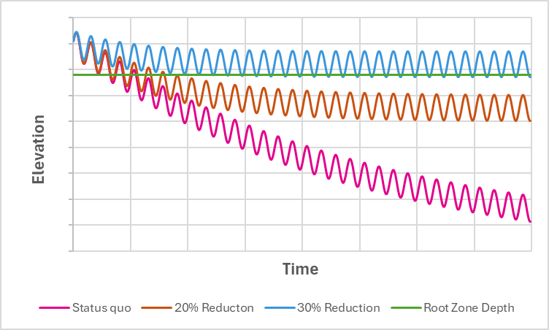
Groundwater-Dependent Ecosystem Example
Dynamically Stable Aquifer Level Consistent with Max Root Zone Depth)
A 30% reduction in pumping is required for this groundwater-dependent ecosystems because the dynamically stable water level is within the root zone depth

Slide 14
Steps to Processing Global Model
Run global groundwater model (presumably GSGM) for a range of global pumping reduction scenarios (e.g., 0%, 10%, …, 90%, 100%)
Model outputs aquifer elevation over time at hi-resolution grid.
Assess percent reduction in pumping necessary to achieve stable aquifer levels per grid cell
Consider groundwater-dependent ecosystems, as appropriate
Spatially average reduction percentages across Pfafstetter Level 5 basins

Slide 15
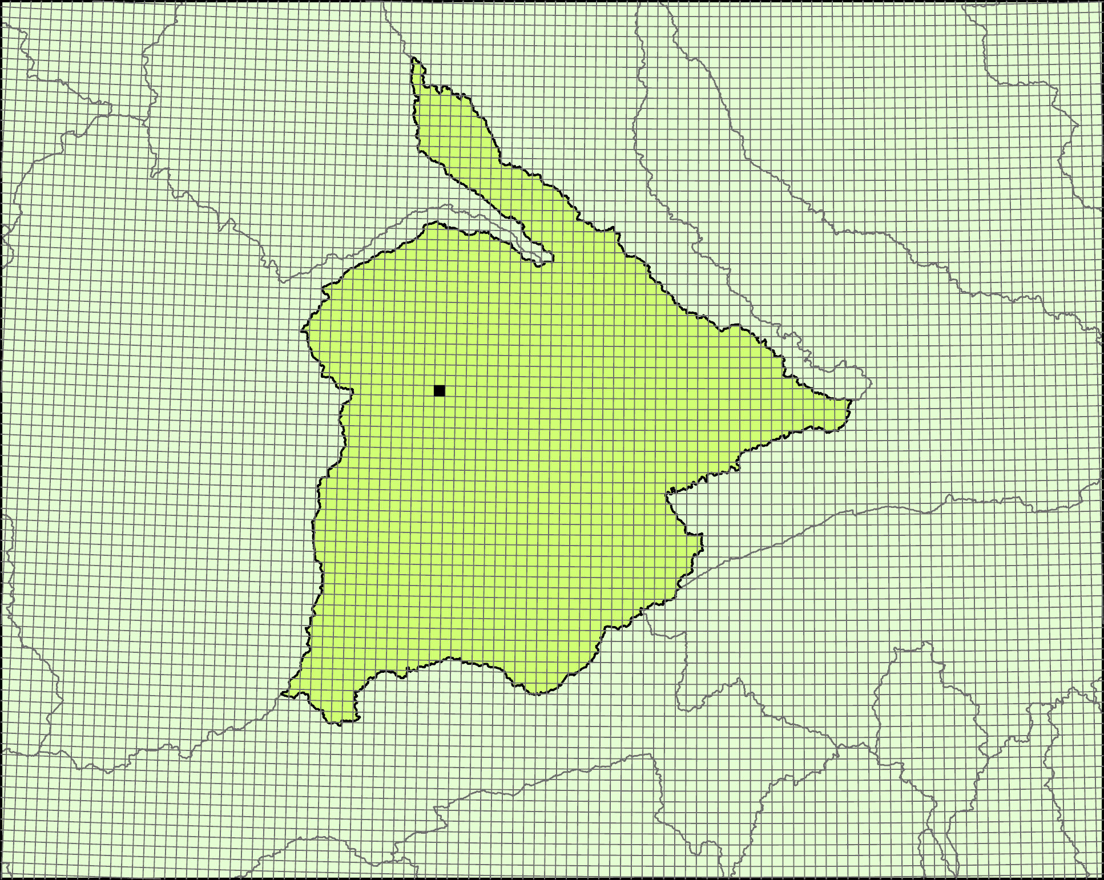
Spatially Average Reduction Percentages Across Pfafstetter Level 5 Basins
Model outputs at high resolution grid
Repeat model output processing described above for each grid cell
Spatially average reduction percentages across Pfafstetter Level 5 basins

Slide 16
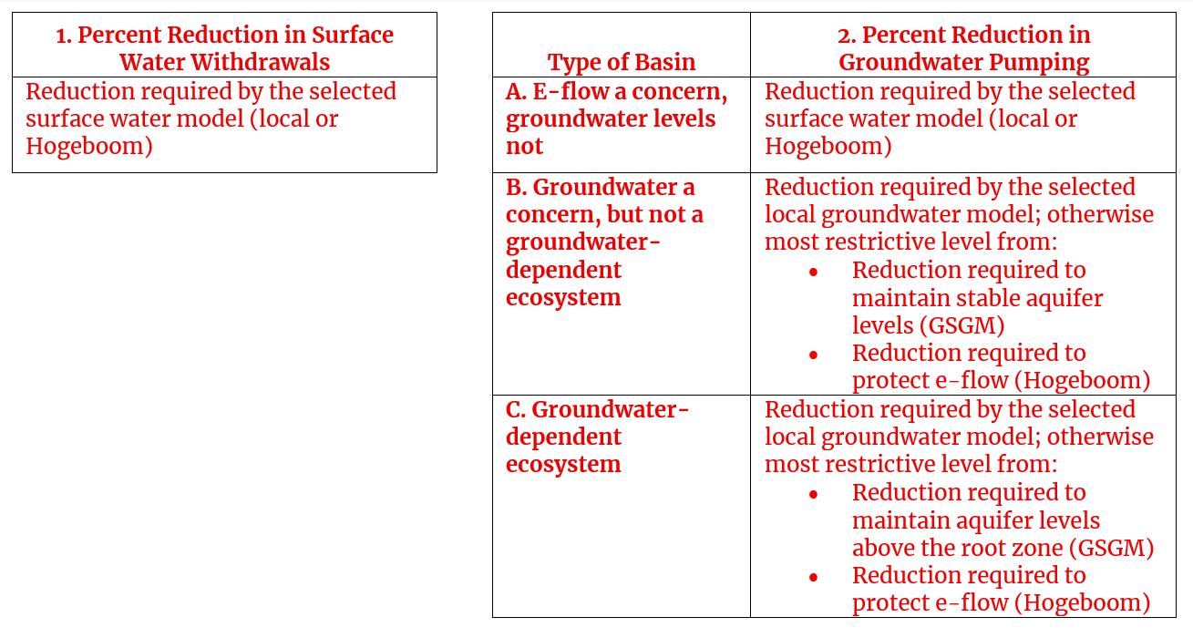
Changes to v1.1 Steps
Calculate baseline water use
Select model
Assess required reduction in water use
Set targets
Target depends on pathway and type of basin

Slide 17
Questions for Reviewers
Spatially average reduction percentages across Pfafstetter Level 5 Basins or base reduction on grid cell with largest required reduction?
Do we consider response time when restoring a degraded groundwater-dependent ecosystem?
**Find all consultation questions in the survey on the Freshwater V2 public consultation landing page

Slide 18
Spatially Average Reduction Percentages Across Pfafstetter Level 5 Basins (or Choose Most Restrictive)?
It may be worthwhile to examine variability in GSGM results prior to deciding

Slide 19
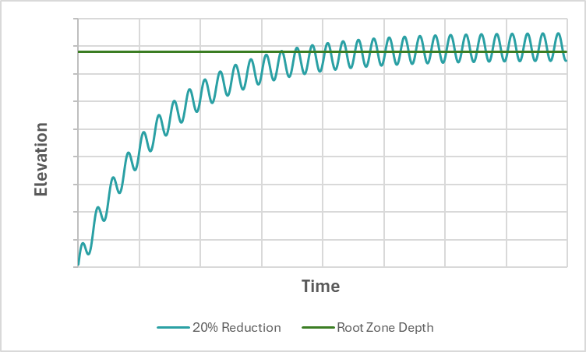
Do We Consider Response Time When Restoring a Degraded Groundwater-dependent Ecosystem?
It may take decades to achieve a dynamically stable aquifer level

Slide 20
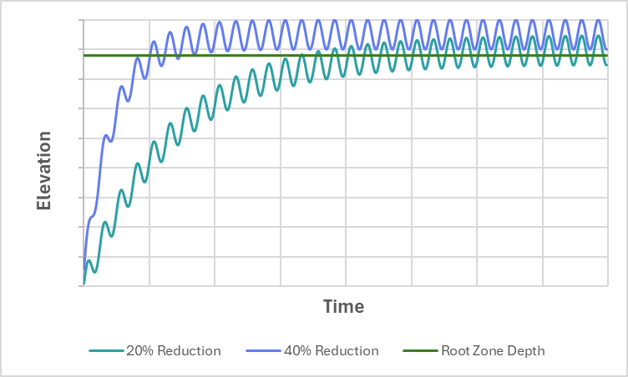
Do We Consider Response Time When Restoring a Degraded Groundwater-dependent Ecosystem?
It may take decades to achieve a dynamically stable aquifer level
Response time can be shortened by selecting a larger reduction percentage

